Slide 1
Nuclear Chemistry
Chapter 18

Slide 2
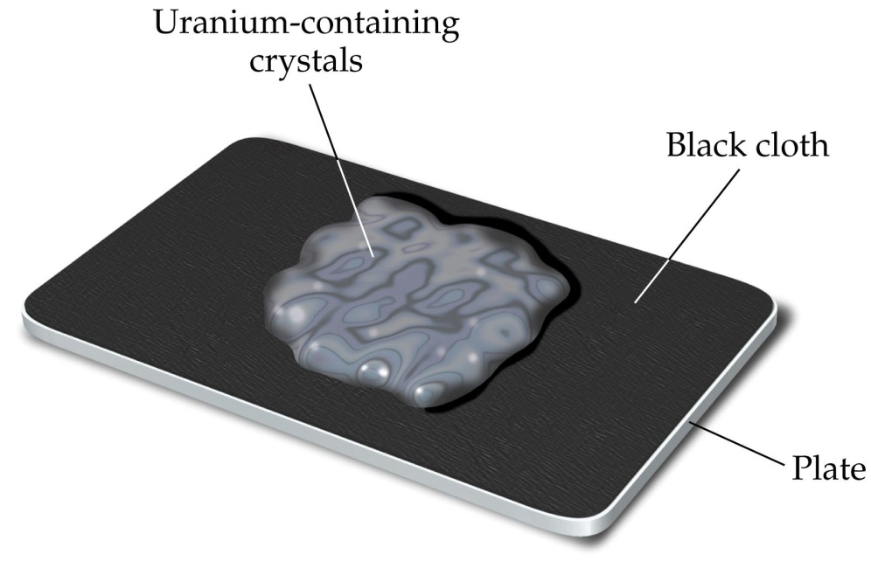
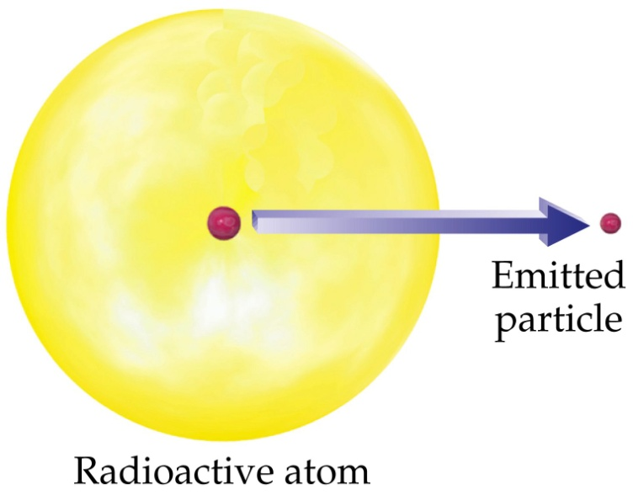
Radioactive Decay
Discovered by Antoine Henri Becquerel in 1896
He saw that photographic plates developed bright spots when exposed to uranium metals

Slide 3
Types of nuclear reactions
Radioactive Decay – nucleus decays spontaneously giving off an energetic particle
Nuclear Bombardment – shoot a high energy particle at the nucleus of another atom and watch what happens

Slide 5
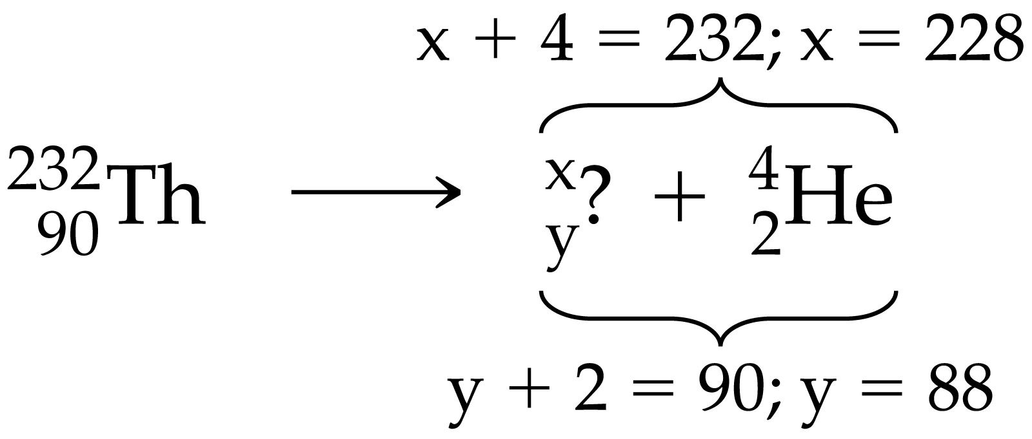
Writing Nuclear Equations

Slide 6
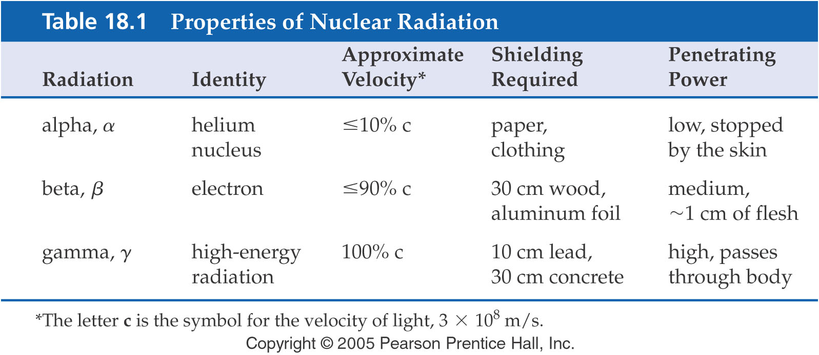

Slide 7
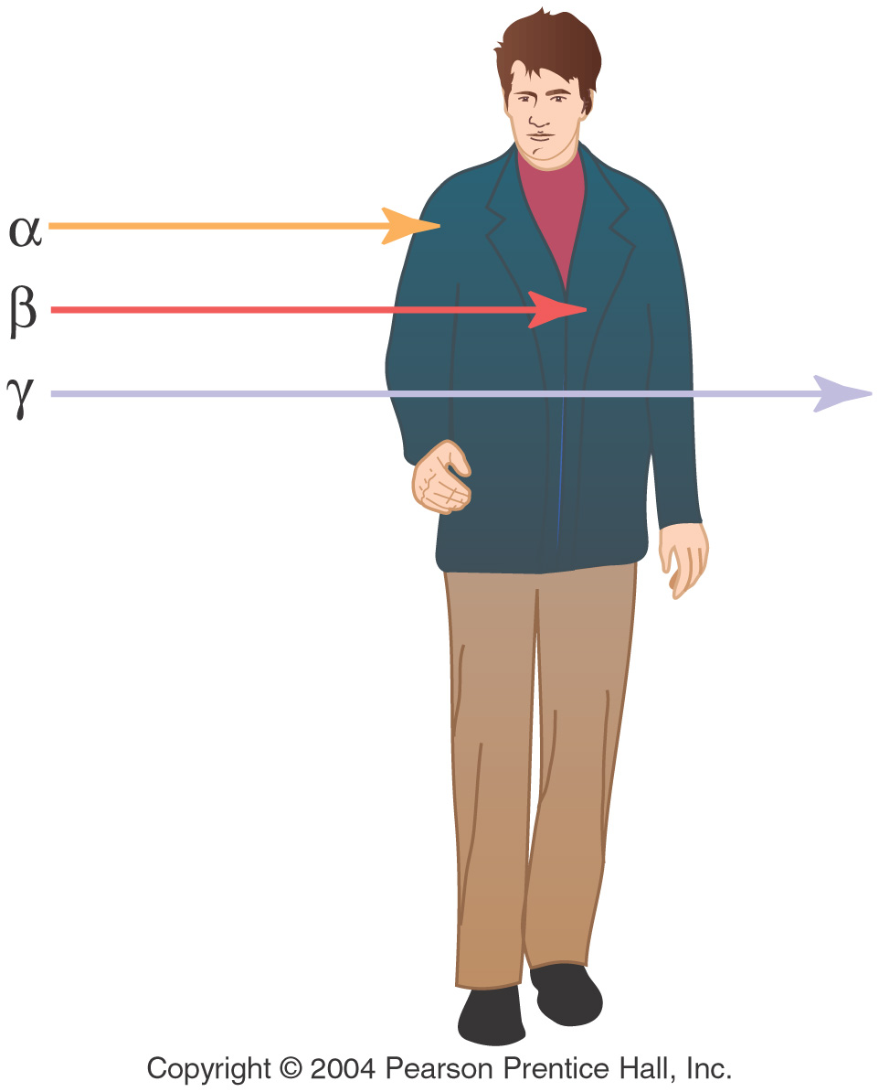

Slide 8
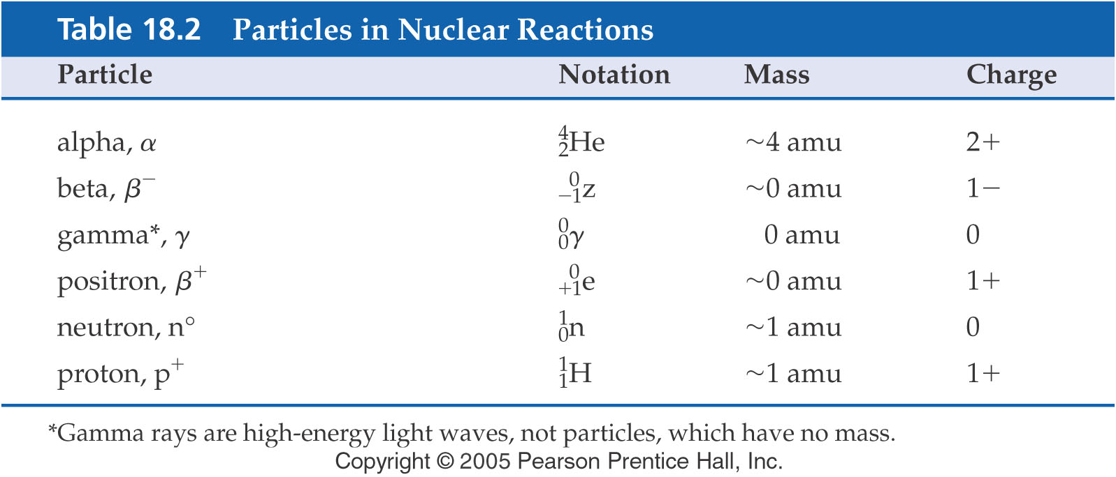
Types of radioactive decay
alpha particle emission
beta emission
positron emission
electron capture
gamma emission

Slide 9
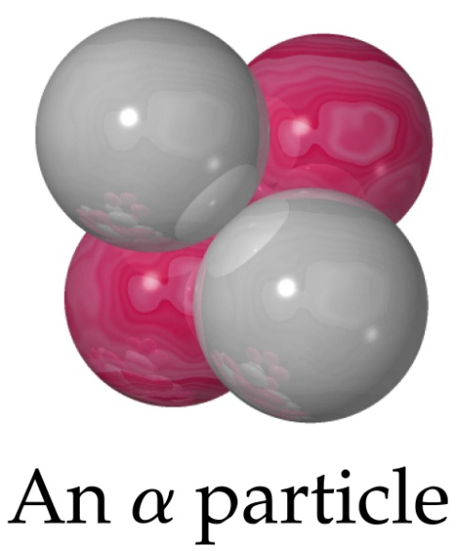
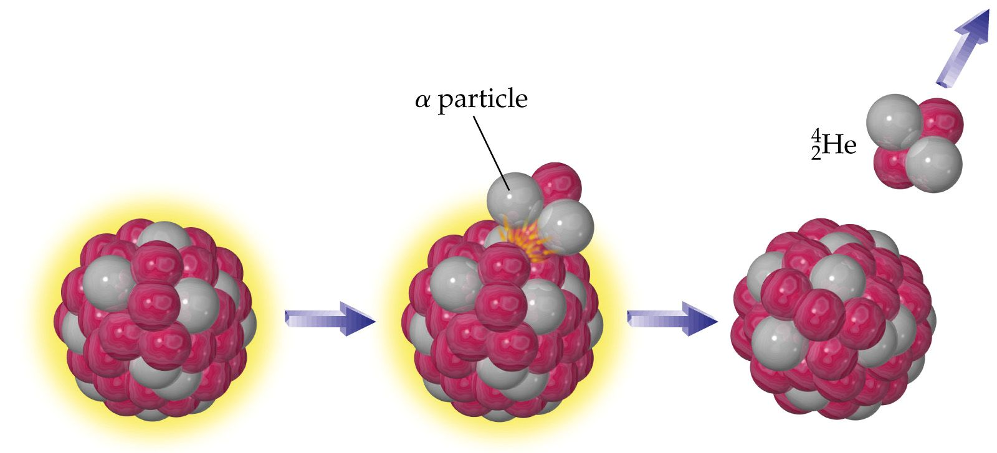
Types of radioactive decay
alpha particle emission
loss of a helium nucleus.

Slide 11
Problem Pu-239 (plutonium 239) loses an alpha particle (He nucleus). Write the nuclear reaction

Slide 12
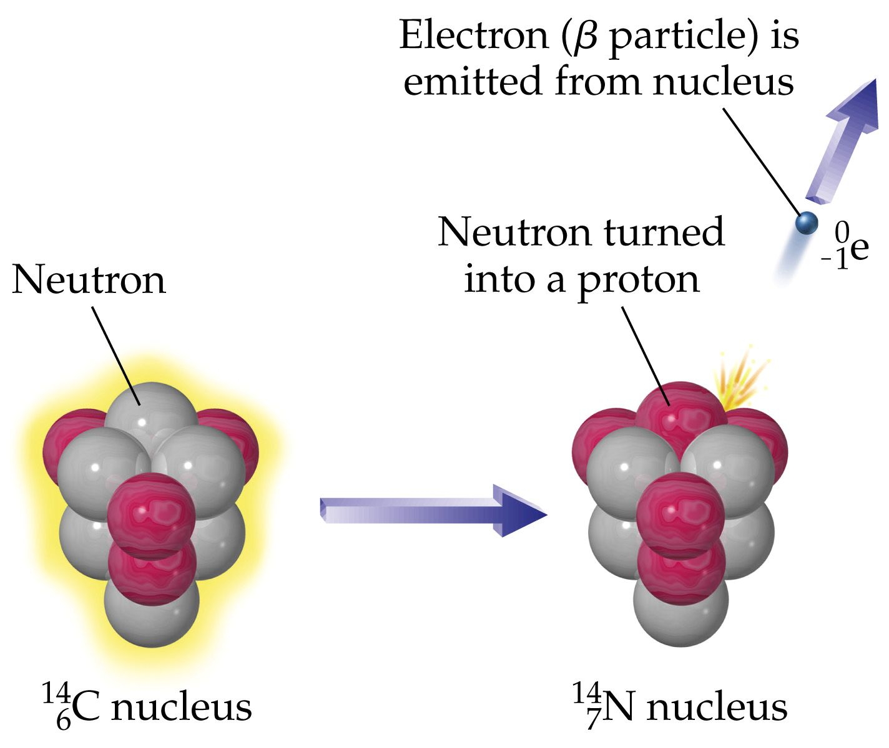
Types of radioactive decay
beta emission
A neutron splits into a proton and electron which is spit out as a b particle.

Slide 13
β particle emission

Slide 14
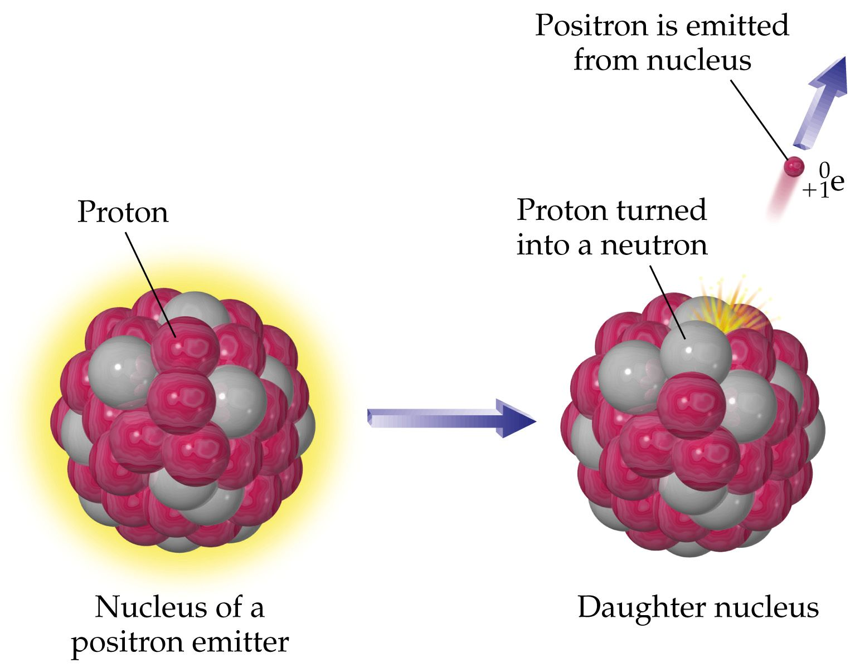
Types of radioactive decay
positron emission
A proton kicks out positive charge (a positron, β+) to become a neutron.

Slide 15
Types of radioactive decay
electron capture (EC)
an electron (from inner shell) is sucked into the nucleus to combine with a proton – produces a neutron.
gamma emission
emission of energy (photon) from an unstable nucleus.

Slide 16
Can we predict types of radioactive decay that will occur?
Nuclear particles are held together by a strong attractive force
Like electrons, protons are arranged in shells
Even numbers of protons and neutrons are most stable.
An approximately 1-1 neutron to proton ration is generally most stable
Atomic number > 83 is never stable.

Slide 17
# protons | # neutrons | # stable isotopes
even | even | 157
even | odd | 52
odd | even | 50
odd | odd | 5

Slide 19
Nuclear Bombardment Reactions
Transmutation – changing one element to another by shooting a nuclear particle at its nucleus.
All transuranium elements (more than 92 protons) were created synthetically in particle accelerators.

Slide 20
Transmutation Reaction

Slide 21
Energy of Nuclear Reactions
6.1512+ 1.00782 ≠ 3.01603 + 4.00260
7.02294 ≠ 7.01863 .

Slide 22
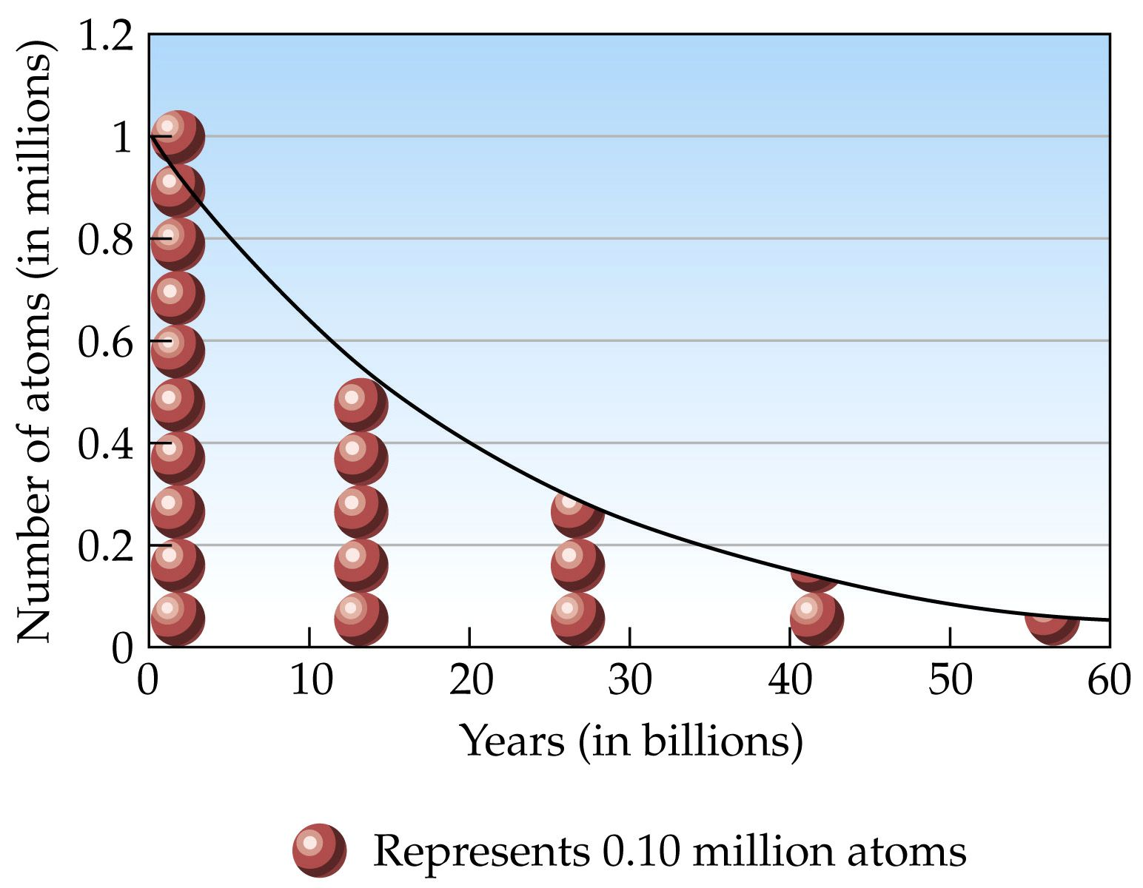

Slide 23
If a radioactive isotope has a ½ life of 20 minutes, what percent of the sample will remain after 1 hour?
If 75% of a sample decays after 6 hours, what is its half life?
If a radioisotope has a half-life of 2 weeks, how long will it take for 99% of the sample to decay?

Slide 24
Applications – Carbon Dating
nitrogen in the atmosphere is bombarded by neutrons to form ¹⁴C
This carbon is integrated into CO₂ which then enters the food chain

Slide 25
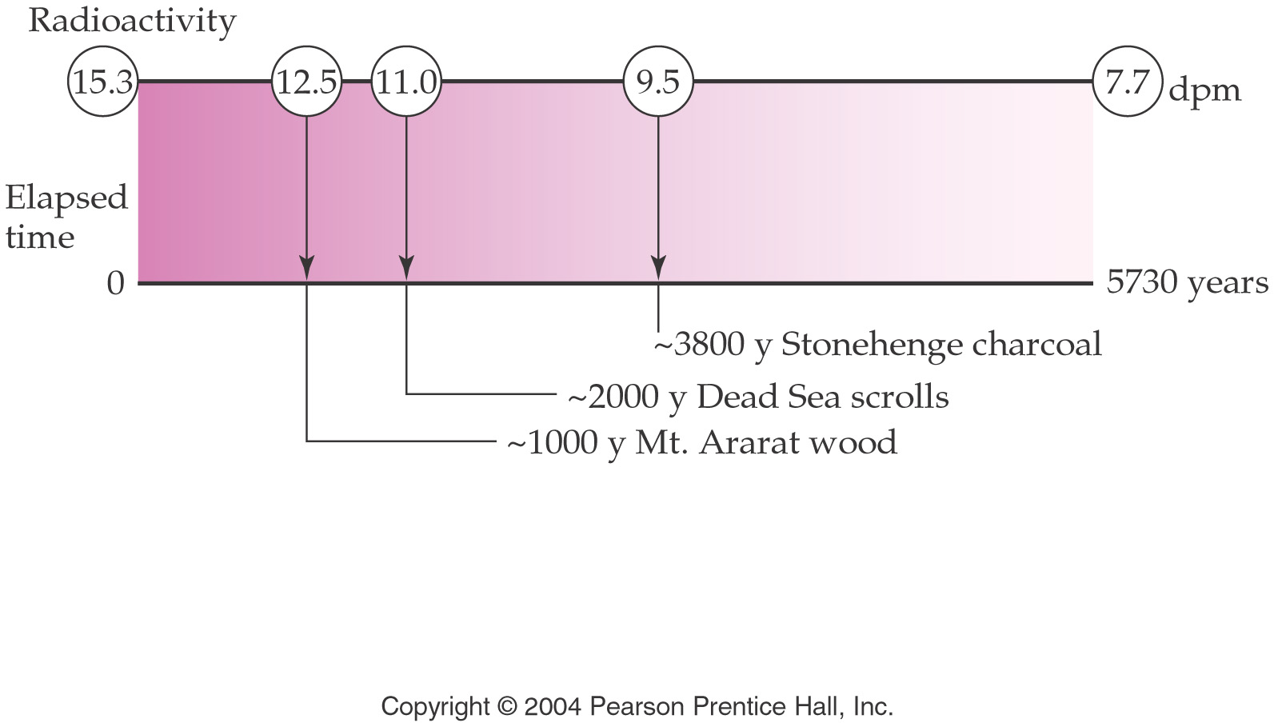
Applications – Carbon Dating

Slide 26
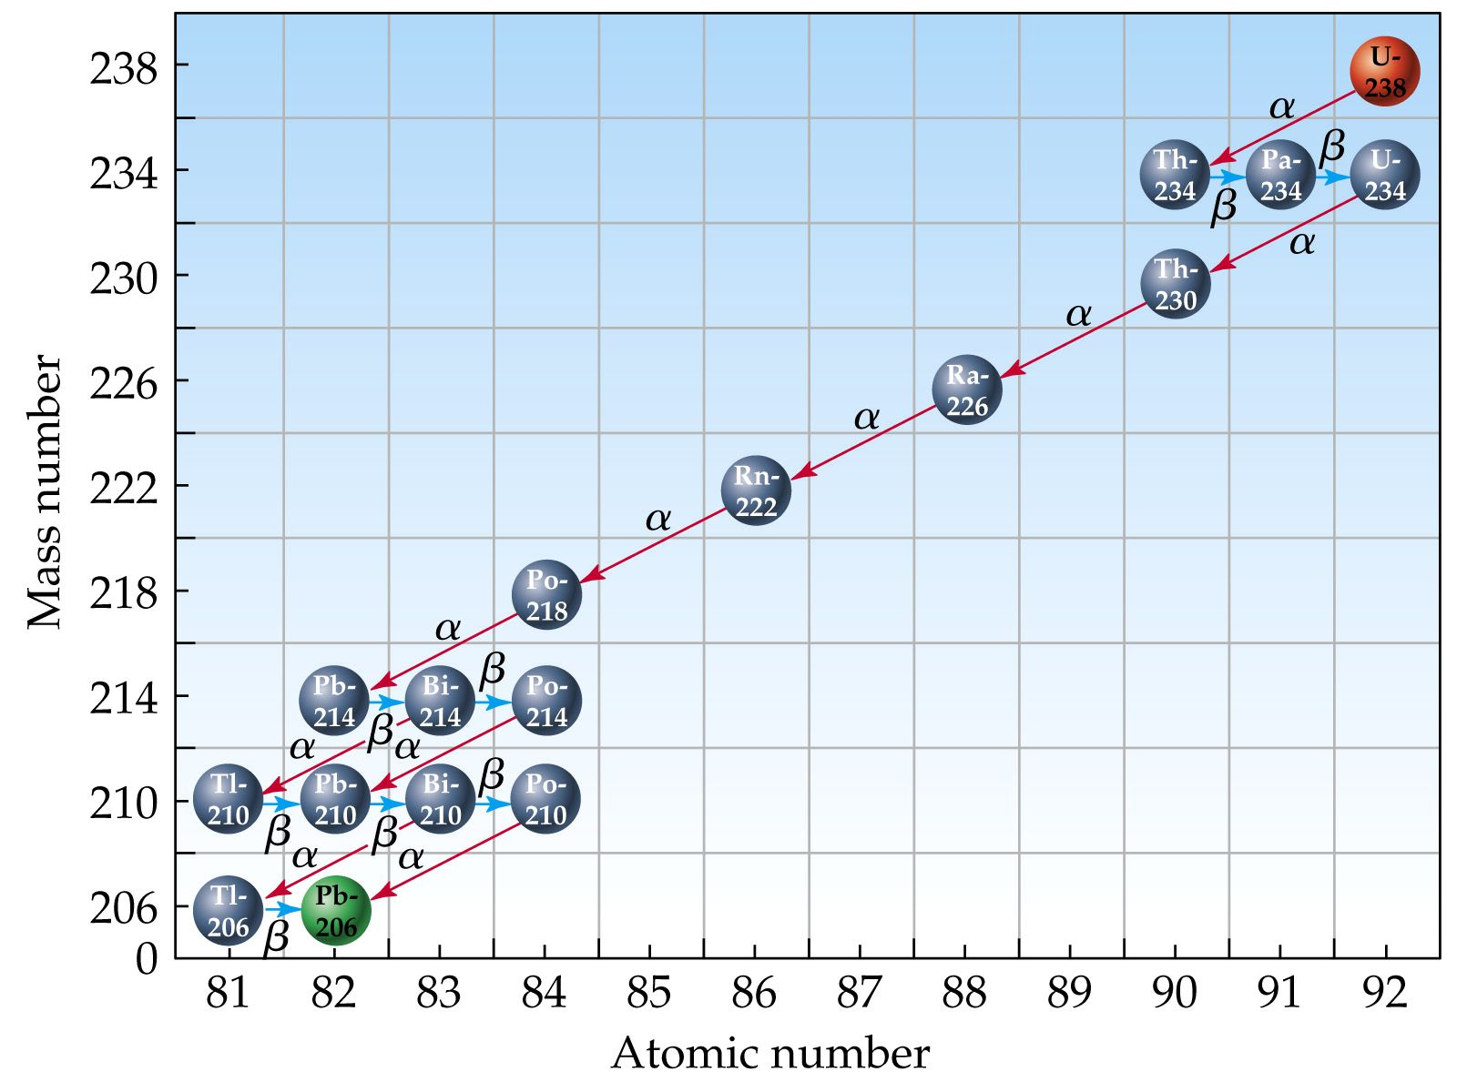

Slide 27
Applications – Chemical Analysis
Radioactive tracer – used to follow fate of a chemical using radio labeling
Isotopic dilution – used to determine quantity of a substance when you can’t measure it conveniently
Neutron Activation Analysis – used to determine concentration of trace elements

Slide 28
Applications - Medicine
Medicine
Diagnostic tracers
PET – Positron Emission Tomography
Patient fed radio-labeled glucose and it goes to where there is lots of metabolic activity. This often indicates a region of tumor activity.
Radiotherapy
Power pacemakers

Slide 29
http://www.orau.org/PTP/collection/Miscellaneous/pacemaker.htm
Nuclear-Powered Cardiac Pacemakers
Pacemakers are used to stimulate a regular heartbeat when the body's natural electrical pacing system is irregular or not transmitting properly. Over the years, various power sources have been used for pacemakers, including thermoelectric batteries containing 2 to 4 curies of plutonium-238 (88 year half-life). As the term "thermoelectric" implies, the heat from the decaying plutonium is used to generate the electricity that stimulates the heart. At present (2003), there are between 50 and 100 people in the US who have nuclear powered pacemakers. When one of these individuals dies, the pacemaker is supposed to be removed and shipped to Los Alamos where the plutonium will be recovered.
Nuclear powered pacemakers were discontinued in the 1970s.

Slide 30
What Is PET
Positron Emission Tomography (PET) is a major diagnostic imaging modality used predominantly in determining the presence and severity of cancers, neurological conditions, and cardiovascular disease. It is currently the most effective way to check for cancer recurrences, and it offers significant advantages over other forms of imaging such as CT or MRI scans in detecting disease in many patients. In 2005, an estimated 1,129,900 clinical PET patient studies were performed at 1,725 sites around the country. If you're interested in learning how a PET scan can benefit you and need additional information, talk with your local health care provider or referring physician. At the end of this page are links to other sites with PET information too.
PET images demonstrate the chemistry of organs and other tissues such as tumors. A radiopharmaceutical, such as FDG (fluorodeoxyglucose), which includes both sugar (glucose) and a radionuclide (a radioactive element) that gives off signals, is injected into the patient, and its emissions are measured by a PET scanner.
A PET scanner consists of an array of detectors that surround the patient. Using the gamma ray signals given off by the injected radionuclide, PET measures the amount of metabolic activity at a site in the body and a computer reassembles the signals into images. Cancer cells have higher metabolic rates than normal cells, so they show up as denser areas on a PET scan. PET is useful in diagnosing certain cardiovascular and neurological diseases because it highlights areas with increased, diminished or no metabolic activity, thereby pinpointing problems.
Cancer and PET
PET is considered particularly effective in identifying whether cancer is present or not, if it has spread, if it is responding to treatment, and if a person is cancer free after treatment. Cancers for which PET is considered particularly effective include lung, head and neck, colorectal, esophageal, lymphoma, melanoma, breast, thyroid, cervical, pancreatic, and brain as well as other less-frequently occurring cancers.
Early Detection: Because PET images biochemical activity, it can accurately characterize a tumor as benign or malignant, thereby avoiding surgical biopsy when the PET scan is negative. Conversely, because a PET scan images the entire body, confirmation of distant metastasis can alter treatment plans in certain cases from surgical intervention to chemotherapy.
Staging of Cancer: PET is extremely sensitive in determining the full extent of disease, especially in lymphoma, malignant melanoma, breast, lung, colon and cervical cancers. Confirmation of metastatic disease allows the physician and patient to more accurately decide how to proceed with the patient's management.
Checking for recurrences: PET is currently considered to be the most accurate diagnostic procedure to differentiate tumor recurrences from radiation necrosis or post-surgical changes. Such an approach allows for the development of a more rational treatment plan for the patient.
Assessing the Effectiveness of Chemotherapy: The level of tumor metabolism is compared on PET scans taken before and after a chemotherapy cycle. A successful response seen on a PET scan frequently precedes alterations in anatomy and would therefore be an earlier indicator of tumor response than that seen with other diagnostic modalities.
From http://interactive.snm.org/index.cfm?PageID=972

Slide 31
http://www.cancer.gov/cancertopics/factsheet/Therapy/radiation
What is radiation therapy?
Radiation therapy (also called radiotherapy, x-ray therapy, or irradiation) is the use of a certain type of energy (called ionizing radiation) to kill cancer cells and shrink tumors. Radiation therapy injures or destroys cells in the area being treated (the “target tissue”) by damaging their genetic material, making it impossible for these cells to continue to grow and divide. Although radiation damages both cancer cells and normal cells, most normal cells can recover from the effects of radiation and function properly. The goal of radiation therapy is to damage as many cancer cells as possible, while limiting harm to nearby healthy tissue.
There are different types of radiation and different ways to deliver the radiation. For example, certain types of radiation can penetrate more deeply into the body than can others. In addition, some types of radiation can be very finely controlled to treat only a small area (an inch of tissue, for example) without damaging nearby tissues and organs. Other types of radiation are better for treating larger areas.

Slide 32
Other Applications
Agriculture
Irradiate food
Pesticide
Energy
Fission
Fusion

Slide 33
Irradiation of food
How will I know if meat and poultry products are irradiated? The international symbol for irradiation, the radura, must be on packages if the entire product was irradiated, as well as the phrase, "treated by irradiation" (or "with irradiation"). The radura, pictured here, can be any color. This required labeling gives consumers the option to choose between irradiated and non-irradiated meat and poultry.
What foods are irradiated? Fresh meat and poultry including whole or cut up birds, skinless poultry, pork chops, roasts, stew meat, liver, hamburgers, ground meat, and ground poultry are approved for irradiation. U.S. food regulations also allow the irradiation of wheat and wheat powder, white potatoes, many spices, dry vegetable seasonings, fresh shell eggs, and fresh produce.
What is food irradiation? Food irradiation is a process in which approved foods are exposed to radiant energy, including gamma rays, electron beams, and x-rays. In 1963, the Food and Drug Administration (FDA) found the irradiation of food to be safe. Irradiation of meat and poultry is done in a government-approved irradiation facility. Irradiation is not a substitute for good sanitation and process control in meat and poultry plants. It is an added layer of safety.
Are irradiated foods safe to eat? Yes. Just as pasteurization makes milk safer, irradiation makes meat and poultry safer by reducing the numbers of harmful bacteria and parasites. Irradiation is an important food safety tool in fighting foodborne illness.
http://www.fsis.usda.gov/Fact_Sheets/Irradiation_and_Food_Safety/index.asp

Slide 34
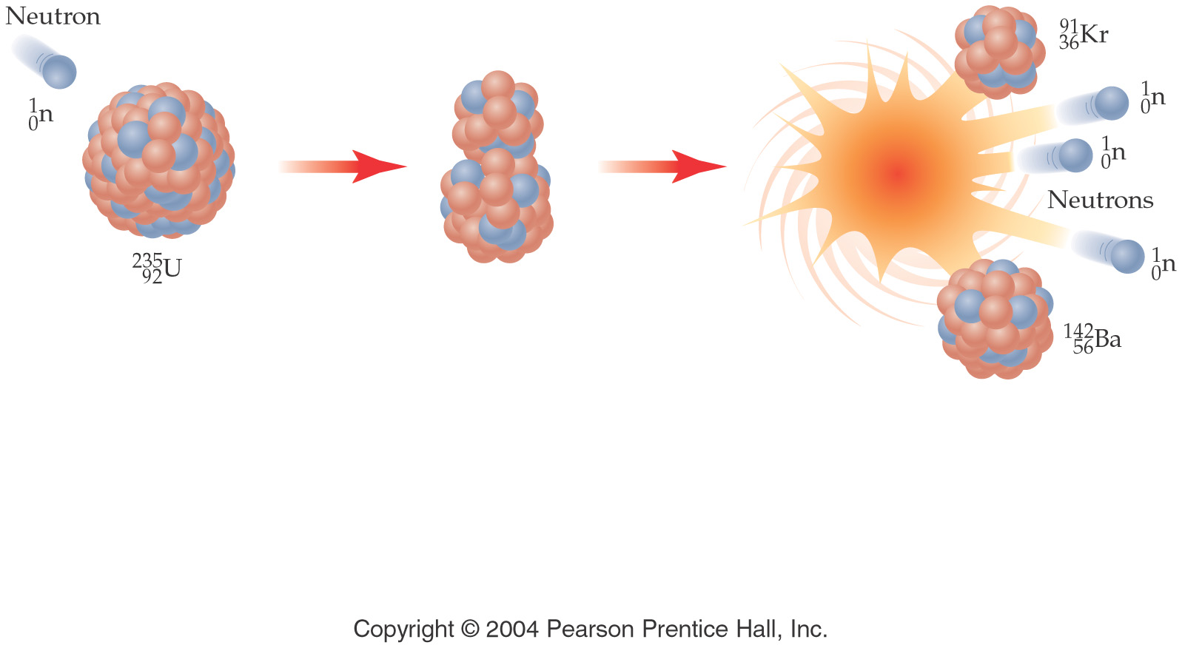

Slide 35
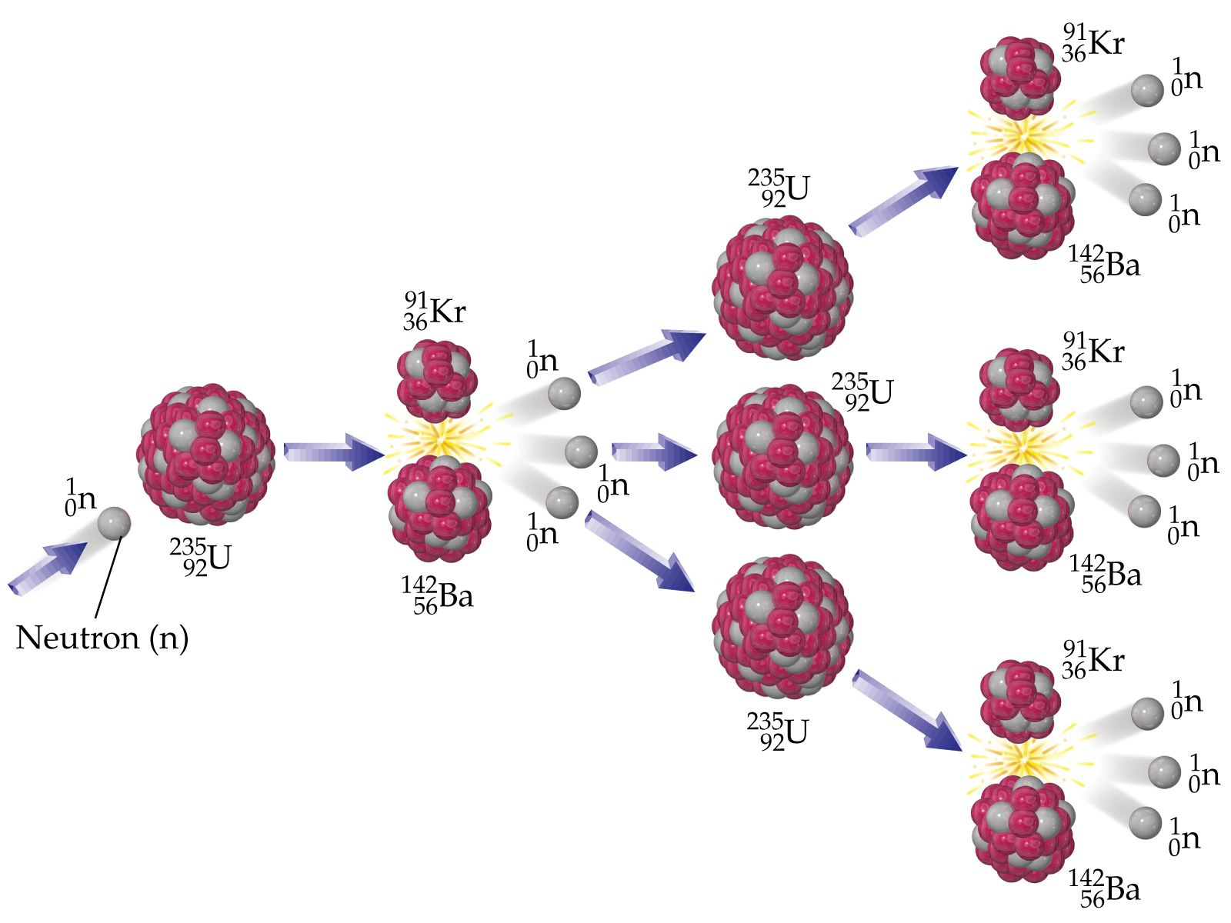

Slide 36
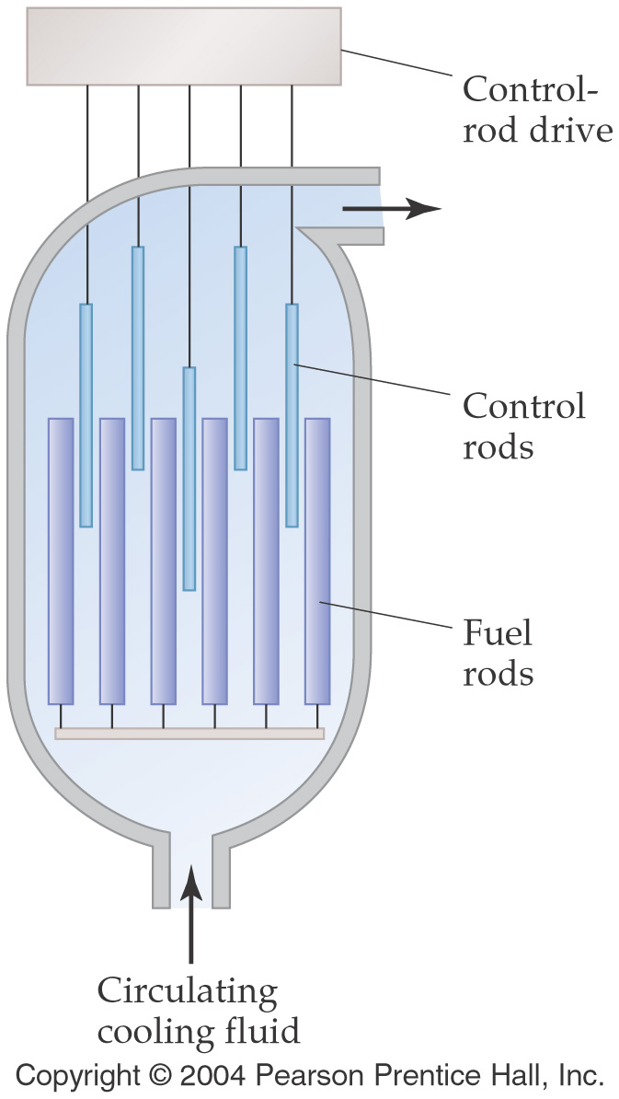

Slide 37
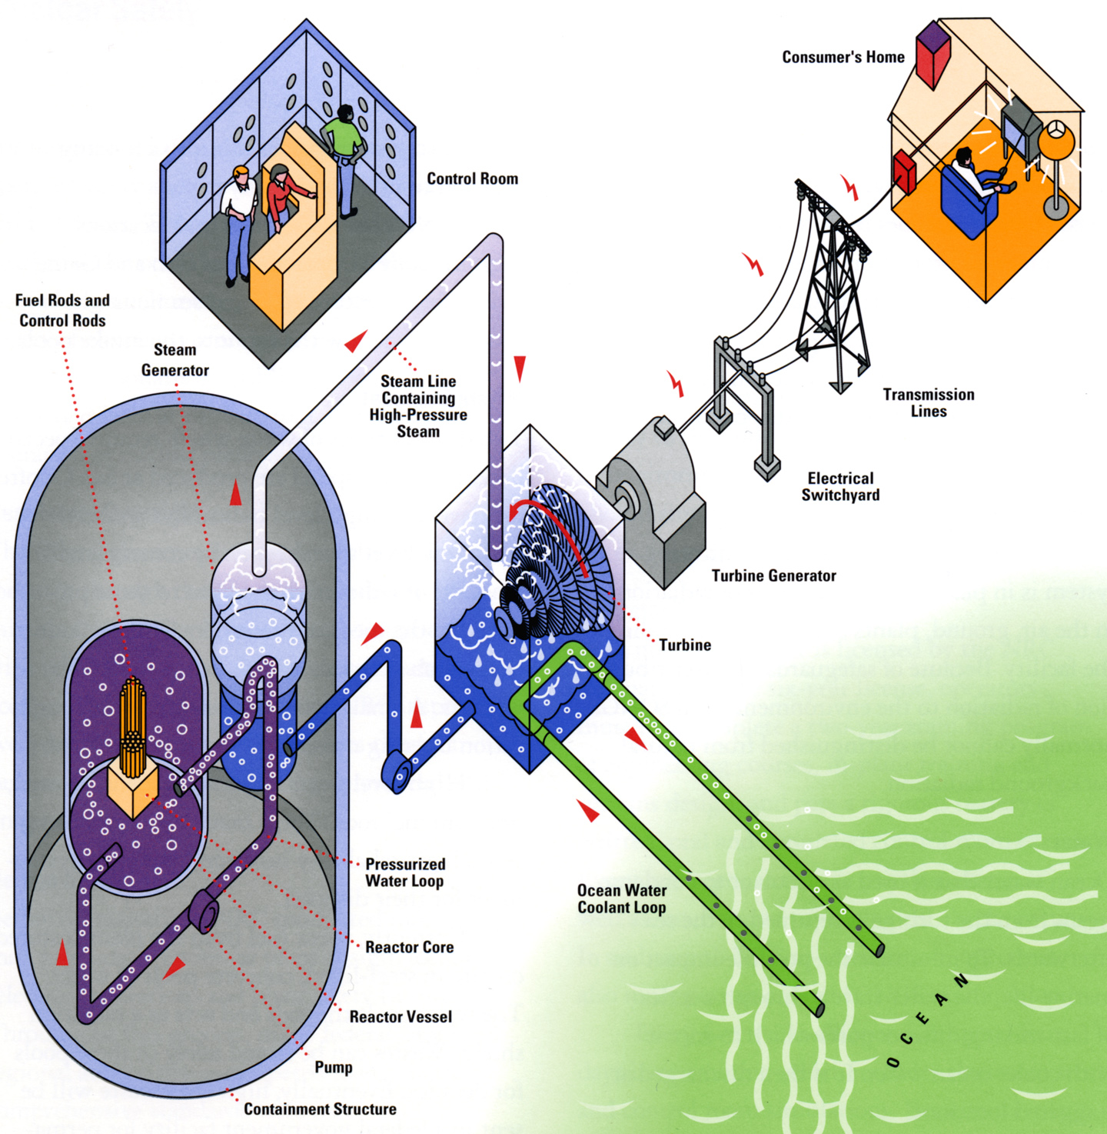
http://www.sce.com/NR/rdonlyres/A050B788-F86C-448A-9A66-8FABD9F302B4/0/NuclearEnergy_process.jpg

Slide 38
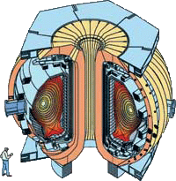
http://fusion.gat.com/global/Basics
What is fusion?
Fusion is the process that powers the sun and the stars. It is the reaction in which two atoms of hydrogen combine together, or fuse, to form an atom of helium. In the process, some of the mass of the hydrogen is converted to energy. Fusion has the potential to be an inexhaustible source of energy.

Slide 39
